Slide 1

Talk JSON to me
Exploring Natural Language Descriptions of JSON files
Holly Hewitt
2463548H
Notes:
Hello! My Name is Holly, and for my level 4 project, I have designed, developed and evaluated a0 tool that generates natural language descriptions of JSON files.

Slide 2
What have we done?
Notes:
So… what have we done

Slide 3
JSONTalk
Built and evaluated JSONTalk: A JSON summarising tool
Easy to understand JSON summary
JSON File
JSONTalk
Notes:
In short, we developed JSONTalk. A customisable command line tool that can take a JSON file, and generate an easy to understand textual summary of the file

Slide 4
Why?
What even is JSON?
Who needs a JSON summarizing tool?
Notes:
Why have we developed JSONTalk? What is the motivation behind the tool?

Slide 5
What is JSON? Who uses it?
JSON is particularly important because it has become one of the most widely used data interchange formats on the web due to its simplicity, flexibility, and compatibility with many programming languages.
It is commonly used for exchanging data between web servers and clients, as well as for storing and sharing data in many other contexts.
Notes:
Firstly, I was to briefly talk about JSON.
-JSON is a data format which is widely used in a variety of different contexts,

Slide 6



3 Personas who would benefit from a JSON summarizing tool
A brief description of the contents of a JSON file can reduce the reading time required to understand the contents and purpose of a JSON file.
Time constrained programmer
Visually impaired programmer
Screen-readers and refreshable braille displays do not allow for simple JSON reading. VI programmers are constrained to hearing punctuation, and reading JSON line by line
VI programmers face many challenges in terms of code and structured text reading
A natural language description is much more screen-reader friendly
An easy-to-understand JSON description could assist a novice programmer in understanding the contents
Novice programmer
Notes:
The people who are most likely to interact with JSON are programmers! Due to its popularity, programmers and developers are likely to have to read and write JSON files during software development.
In particular, we identified 3 different types of programmers who may benefit from a JSON summarising tool and modelled them as user personas, analysing the unique challenges faced by user personas.
Whilst all 3 user personas could benefit from a JSON summarising tool in different ways and the development of user stories for each user persona has informed our research , it should be noted that we have focused our efforts on the development of a tool for visually impaired programmers specifically, due to the importance of addressing accessibility challenges.

Slide 7
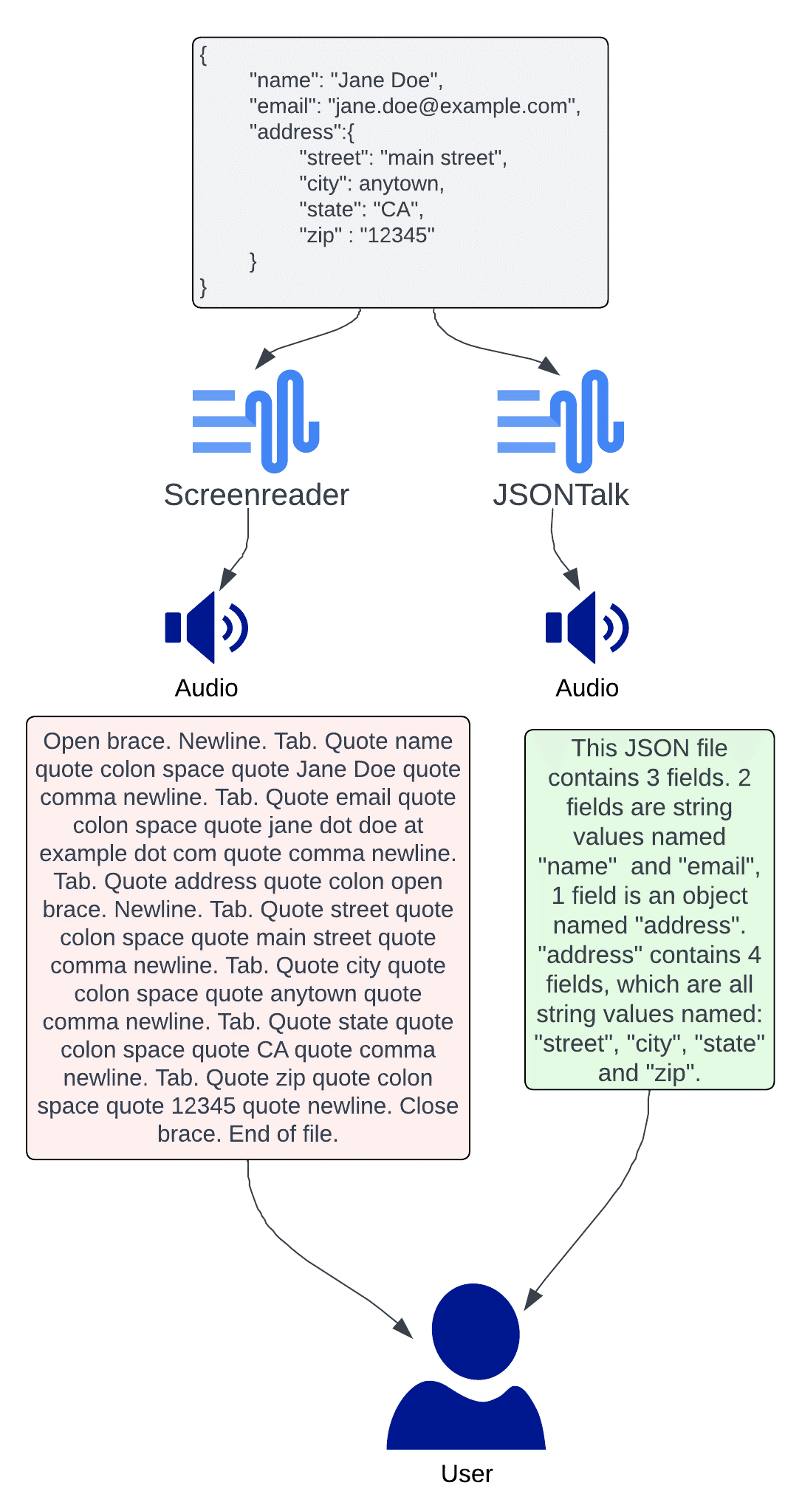
The problem that inspired JSONTalk:
Screenreaders!
Notes:
In fact, accessibility was one of the key issues that motivated the development of JSONTalk. The poor level of interaction between screen readers and JSON files poses an accessibility barrier for Visually impaired programmers. One of the claimed benefits of using JSON as a data format is its readability, however this is not the case for screen-readers reading out JSON files. Our JSONTalk tool is presented as a solution to the poor levels of understandability of screen-reader representations of JSON files.

Slide 8
What other problems are faced when using assistive technology for programming tasks?
“
Notes:
This problem prompted us to explore the other problems faced by visually impaired programmers, specifically when using assistive technology to perform programming tasks.

Slide 9
Interacting with code and structured text using assistive technology
Limited to reading code sequentially (line by line)
Harder to skim code
Harder to back-track
Harder to search through a code-base

Slide 10
Interacting with code and structured text using assistive technology
Limited access to visual information
Miss out on syntactic visual cues
Miss out on diagrams, charts and graphs
Miss out on debugging visual cues

Slide 11
Interacting with code and structured text using assistive technology
Incompatible graphical user interface
IDEs
Block-based programming
Modelling and diagramming apps (UML etc)

Slide 12
Interacting with code and structured text using assistive technology
Web accessibility
Code documentation
Debugging assistance

Slide 13
Interacting with code and structured text using assistive technology
Harder to edit code without losing focus
Virtual cursor control: Harder to go back to original point of focus

Slide 14
Interacting with code and structured text using assistive technology
Time
Harder to skim code
Poor code representation may require multiple read throughs
Consistency
Different screen-readers may give different code representations

Slide 15
Interacting with code and structured text using assistive technology
Size (specific to braille displays)
More expensive as size increases
Braille displays range from 14-80 cells
1 line of code = Multiple lines on a braille display
CPL standard often not enforced

Slide 16
Background research overview
Tools developed for VI programmers
Educational tools
IDE plugins
Code summarisation techniques
Information retrieval techniques
Abstractions: Stereotyping & micropatterns
Accessible programming languages
Standalone tools
Vocal interfaces
Natural language processing
Machine learning
Artificial intelligence
Notes:
We conducted further background research and looked at the existing tools developed for Visually Impaired programmers, in addition to the current state of the art code summarisation techniques. The code summarisation techniques we looked at were mainly for automated code documentation, and whilst well documented code can benefit all programmers, including visually impaired programmers, we believe that some of these techniques could be further harnessed and integrated with tools for Visually impaired programmers

Slide 17
Design & Implementation
Notes:
Over the next few slides I will discuss the steps we took to design and implement the JSONTalk tool

Slide 18
How did we design JSONTalk
We analysed JSON abstract syntax trees, and using the results from stage 1, we generated a formal mapping from JSON syntax to natural language.
User research
We asked 10 students to summarize a JSON file. The results were used to inform our description design.
User personas
We considered the challenges faced by each user persona, in particularly challenges faced by VI programmers
User stories & scenarios
We wrote a set of user stories & scenarios to further inform the design of the tool
From the user stories we developed and prioritized a set of functional & non-functional requirements
Description design
Formal specification
1
2
3
4
5
Notes:
Firstly, in addition to the background research detailed in the previous slides, we conducted initial research where we collected JSON descriptions from 10 different computer science students, and performed word frequency analysis to understand what words programmers like to use when describing JSON files. The results of this informed the design of the description. We also further developed the user personas and created user stories and scenarios. The outcome of these processes was a formal specification, and a formal description design consisting of mapping syntactic JSON elements to natural language constructs

Slide 19
JSONTalk specification
Functional Requirements
The tool must generate human-readable descriptions of JSON files, using simple and commonly used vocabulary that is easy for novice programmers to understand.
The tool must parse JSON files of any size and complexity.
The tool must allow users to customise the output description to suit their needs.
The tool must handle all types of JSON data, including numbers, strings, booleans, null values, arrays, and nested objects.
The tool must be able to generate descriptions for any JSON file stored locally.
The tool must be able to handle errors and give users meaningful error messages.
The tool must have an option for descriptions to be written to a text file, so that users who use accessibility aids can access the description on a text file app if they prefer.
Notes:
This slide shows the functional requirements we wrote for the JSONTalk tool. To summarise these, we wanted the tool to generate clear, understandable descriptions of any JSON file, and also be customisable.

Slide 20
JSONTalk specification
Non-Functional Requirements
The tool must be straightforward to use for both experienced and novice programmers. A usability evaluation using the SUS questionnaire must yield a usability score of above 75.
Thetool must work with the three most commonly used screen-readers: JAWS, NVDA and VoiceOver.
The tool must generate descriptions of JSON files quickly and efficiently.
The descriptions generated by the tool must be of consistent quality, regardless of the input JSON file.
The tool must be compatible with the latest versions of Windows, macOS, and Linux operating systems.
The tool must be well-documented, with clear instructions presented to users.
Notes:
The non-functional requirements we developed for JSONTalk can be summarised as : we want the tool to be usable, work on a variety of different operating systems, and integrate well with screen-readers

Slide 21
Implementation
Printed on command line, saved to text file, or read-aloud.
User input is lexed
Description options are recorded. A lexer converts the JSON file into a set of tokens.
Tokens are parsed
The JSON tokens are parsed and an Abstract Syntax Tree is formed
Abstract Syntax tree is traversed
Using a visitor design pattern, we traversed the abstract syntax tree. During the traversal we collected information required for the description and added them to a secondary data structure
Secondary data structure is traversed
Description given to user
Notes:
This slide illustrates the implementation steps taken to generate the description.
We made use of antlr4, a popular parser generator tool to generate a JSON lexer and Parser which convert any JSON file into an abstract syntax tree.
We then used a visitor design pattern to traverse the abstract syntax tree, generate a secondary data structure, traverse the secondary data structure, and generate the description.

Slide 22
JSONTalk: Single Slide Overview
JSONTalk is a command line tool built to generate descriptions of JSON files.
3
2
3
Levels of Description
Additional description options
Output options
Top Level
Structural
Full
Describe the JSON file up to a specific depth
Add contextual depth details to each description line
Print to command line
Write to text file
Read-aloud
Notes:
We mentioned in the requirements of the tool we wanted the tool to be customisable. The tool can generate 3 different types of description, varying in detail. We also added 2 different options which allow users to customise each of the three descriptions. Users can specify a depth they want the description to stop at, which is useful for larger JSON files, and users can add contextual details of depth of each line of the description. We also allowed for 3 different output methods for the description, including printing on the command line, reading aloud, or saving the description to a text file.

Slide 23
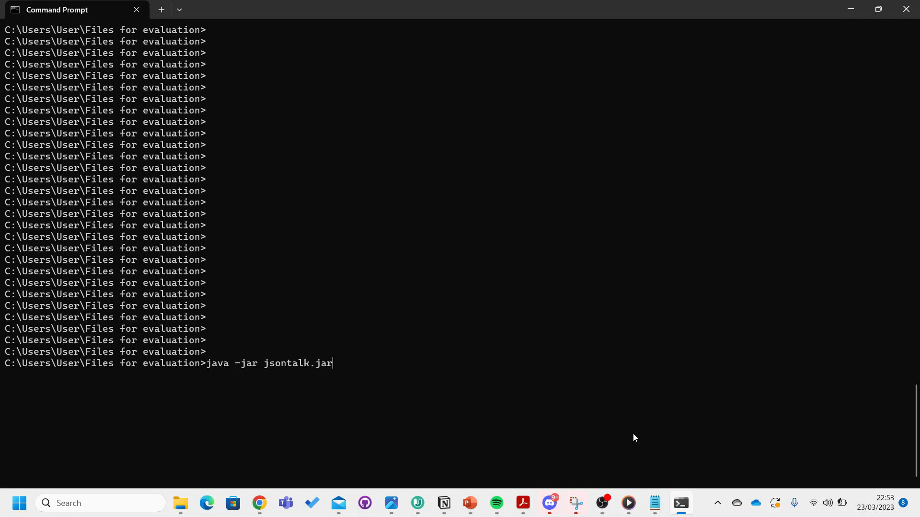
Demonstration

Slide 24
JSONTalk evaluation
Notes:
I will now take you through the evaluation of the JSONTalk tool

Slide 25
Evaluation Overview
Does JSONTalk allow users to quicker understand the structure and contents of a JSON file compared to when it is represented by a screen reader?
Does JSONTalk accurately represent the contents of a JSON file?
Between subjects A/B testing design
5 research questions
40 participants
Run remotely
Does JSONTalk help users identify the presence of objects with identical structure?
Is the JSONTalk tool usable?
Does JSONTalk help users identify the context of individual key-value pairs within the JSON file?
Notes:
We conducted a between subjects A/B test, where group A used the JSONTalk tool and group B did not. Unfortunately, our study only included sighted participants, so to mitigate this and simulate a use case more representative of how Visually impaired programmers may interact with the tool, we did not present any participants with JSON files. Instead we presented participants with screen-reader JSON file representations. We recognise that not having any visually impaired study participants is a major limitation of this study.

Slide 26
Question Breakdown
Questions about written JSON
Depth based question
Identical object identification
Rewrite JSON file
Questions about spoken JSON
Depth based question
Identical object identification
SUS questionnaire (only for group using the tool)
Notes:
In the study, participants were asked a series of questions about the underlying JSON files from the screen-reader representations. Group A were allowed to use the JSONTalk tool to supplement the screen-reader transcripts. We asked a depth based question to understand whether the JSONTalk tool allowed for users to better understand the context of specific elements within JSON files, and we asked the identical object identification question as the identification of similarly structured JSON objects can inform users a lot about the use of a JSON file. Questions 1 & 3 were similar, however, question 1 used written representations, and question 3 used spoken representations. We asked question 2 to understand whether the JSONTalk tool is accurate. Finally, we answered a usability questionnaire.

Slide 27
What we measured
Questions about written JSON: Accuracy rate and timing
Depth based question
Identical object identification
Rewrite JSON file: Accuracy rate and timing
Questions about spoken JSON: Accuracy rate and timing
Depth based question
Identical object identification
SUS questionnaire (only for group using the tool): Calculated the SUS score
Notes:
This slide just shows what we measured at each stage of the evaluation.

Slide 28
Results
The JSONTalk tool can help users better understand the depth of elements within JSON files compared to just using a screen reader.
The JSONTalk tool allows for users to more quickly and accurately decipher a JSON file, compared to users using a screen reader.
More work needs to be done for the JSONTalk tool to give users a better overview of identical objects within JSON files.
More work needs to be done to improve the usability of the tool
Notes:
In terms of results of the experiment, we found that the JSONTalk tool is valuable for improving user understanding of element depth within JSON files, as well as helping users decipher JSON files more quickly and accurately. We also found that more work needs to be done in terms of identical object representation and tool usability.

Slide 29
Thank you for watching!
Contact details:
Holly Hewitt
2463548h@student.gla.ac.uk
JSONTalk repository:
https://github.com/holly-hewitt/JSONTalk

